Slide 1
EXPLORATORY DATA ANALYSIS
3 key steps:
(1) Examining the size and shape of your data
(2) Basic cleaning of your data
(3) Discovering and visualizing statistical relationships and patterns

Slide 2
EXPLORING STATISTICAL RELATIONSHIPS
Numerically
Correlations
Visually
(Scatter plots)
Heat maps

Slide 3
CORRELATIONS
Correlation: how strong is the (statistical) relationship between two variables?
describes, not explains the relationship between two variables
tells us nothing about cause-and-effect
If var1 and var2 have a strong, positive correlation
This does not mean that an increase in var2 causes an increase in var1 or vice versa
This simply means that as var1 increases, var2 also tends to increase
Correlation can be negative, positive, or minimal/zero
Correlation coefficient calculation methods:
(1) Pearson’s (measures only linear relationship)
(2) Spearman’s Rank (can measure non-linear relationships as well)

Slide 4
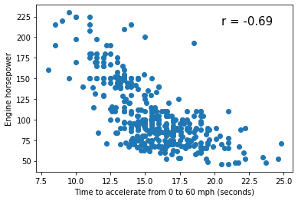
CORRELATIONS
Correlation coefficient, r:
Ranges between -1 and 1
|r| >= 0.7 suggests “strong” relationship
Coefficient of determination, R²:
Is (correlation coefficient)²
Ranges between 0 and 1
R² > = 0.5 suggests “strong” relationship

Slide 5
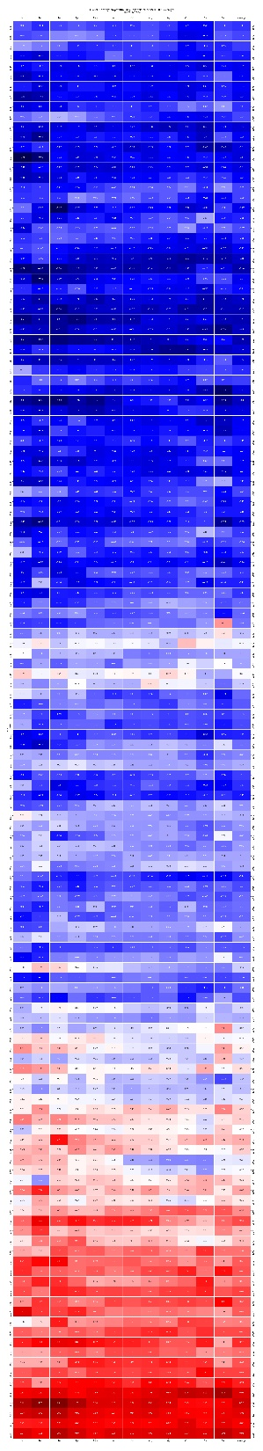
HEATMAP
1880
Powerful example:
Monthly temperature anomalies
A plot of data color-coded by value
Many applications!
Image produced by the Climate Council: https://www.climatecouncil.org.au/resources/140-year-heat-map-shows-clear-trend-global-temperature-change/, using data from NOAA National Centers for Environmental Information, Climate at a Glance: Global Time Series, published January 2020, retrieved on January 18, 2020 from https://www.ncdc.noaa.gov/cag/
2020
Notes:
Climate Council of Australia Ltd copyright material is licensed under the Creative Commons Attribution 3.0 Australia License. To view a copy of this license visit https://creativecommons.org/licenses/by/3.0/au/

Slide 6
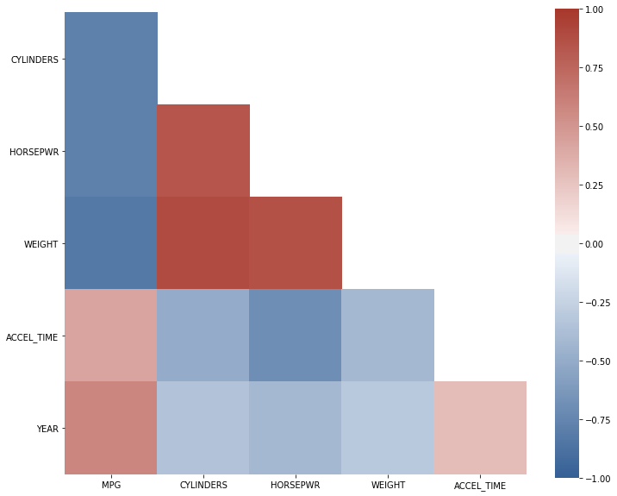
HEATMAP
A plot of data color-coded by value
Many applications!
Here: color-coded correlation coefficients to visually examine relationships for many sets of variables!
Could also look at a matrix of scatterplots!

